Slide 1
Real-Time Accurate Stereo Matching using Modified Two-Pass Aggregation and Winner-Take-All Guided Dynamic Programming
Xuefeng Chang, Zhong Zhou, Yingjie Shi, Qinping Zhao
- State Key Laboratory of Virtual Reality Technology and
Systems, Beihang University, Beijing 100191, China
Liang Wang
-University of Kentucky, Lexington, KY, USA
2011 International Conference on 3D Imaging, Modeling, Processing, Visualization and Transmission (3DIMPVT)

Slide 2
Outline
Introduction
Framework
Proposed Algorithm
Weight computation
Two-pass aggregation based on credibility estimation
Winner-take-all guided DP
Experimental Results
Conclusion

Slide 3
Introduction

Slide 4
Background
Global stereo algorithms:
Minimize certain cost functions
Belief propagation, Graph-cut
High accuracy but low speed
Local stereo algorithms :
Based on correlation (in local support window)
Fast implementation

Slide 5
Objective
Present a real-time stereo algorithm
Improve the accuracy over scanline-based approach
Perform in real-time with high quality
Related to [20] and inspired by [12]
[20] K.-J. Yoon and I.-S. Kweon, “Locally adaptive support-weight approach for visual correspondence search,” in Proc. of IEEE Conf. on Computer Vision and Pattern recognition, 2005, pp.924–931.
[12] L. Wang, M. Liao, M. Gong, and R. Yang, “High-quality real-time stereo using adaptive cost aggregation and dynamic programming,” in Intl. Symposium on 3D Data Processing,
Visualization and Transmission, 2006, pp. 798–805.

Slide 6
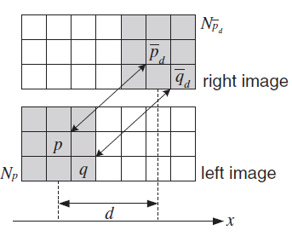
Locally Adaptive Support-Weight Approach[20]
Fix-sized support window
Based on color similarity and
geometry similarity
strong results but time
consuming
[20] K.-J. Yoon and I.-S. Kweon, “Locally adaptive support-weight approach for visual correspondence search,” in Proc. of IEEE Conf. on Computer Vision and Pattern recognition, 2005, pp.924–931.

Slide 7



Locally Adaptive Support-Weight Approach[20]

Slide 8
Framework

Slide 9
Framework
Weight Computation
Compute weight for each pixel
Two-pass aggregation
Aggregate matching cost
2D aggregation → two 1D windows
Winner-take-all
Improve dynamic programming(DP) optimization technique
Occlusion boundary improving
CPU and GPU in parallel
Acceleration using graphics hardware
O(S²) → O(S)
Speed acceleration
By color similarity

Slide 10
Weight Computation

Slide 11


Weight Computation
Pixel-wise matching cost:
p : pixel in the left image
d : disparity hypothesis
pixel in the target image $\overline{p}$ = (x+d, y)

Slide 12
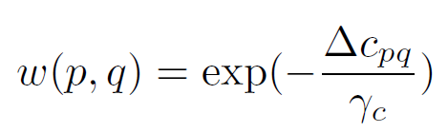
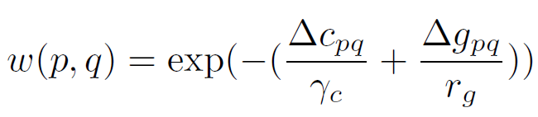
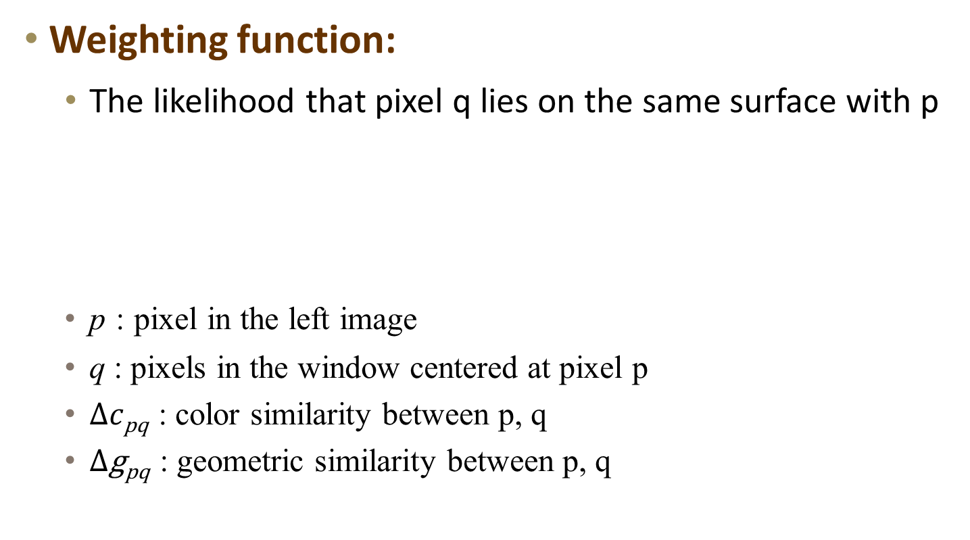
Weight Computation
Weighting function:
The likelihood that pixel q lies on the same surface with p
p : pixel in the left image
q : pixels in the window centered at pixel p
$∆c\text{pq}$ : color similarity between p, q
$∆\text{g}\text{pq}$ : geometric similarity between p, q

Slide 13
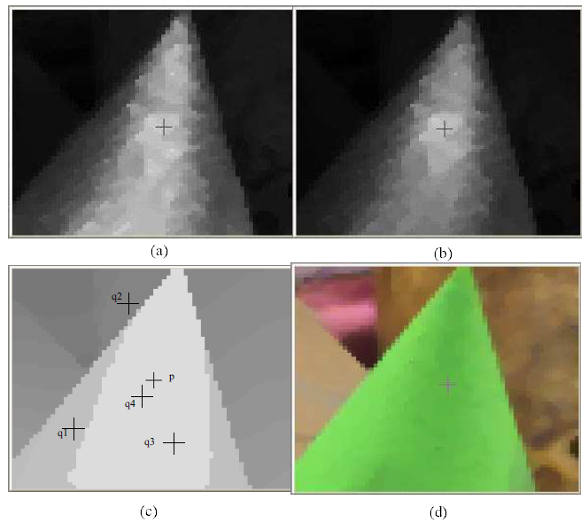
Weight Computation
Color
Color + Geometry

Slide 14
Two-Pass Aggregation

Slide 15
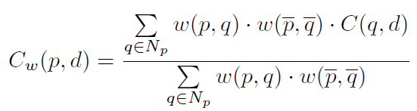
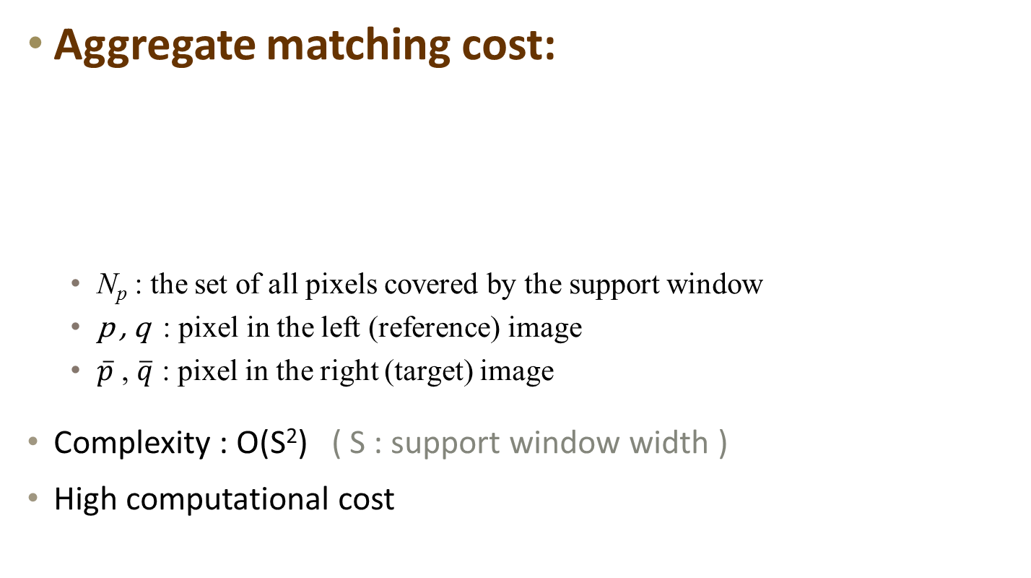
Aggregation
Aggregate matching cost:
N_{p} : the set of all pixels covered by the support window
p , q : pixel in the left (reference) image
$\overline{p}$ , $\overline{q}$ : pixel in the right (target) image
Complexity : O(S²) ( S : support window width )
High computational cost

Slide 16
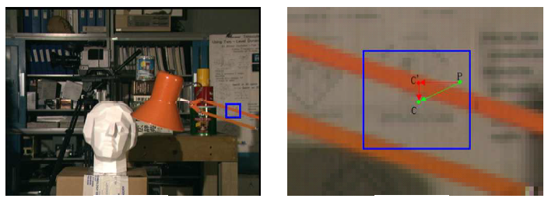

Two-Pass Aggregation
2D aggregation → separate 1D windows
Horizontal & vertical
Complexity : O(S²) → O(S)

Slide 17
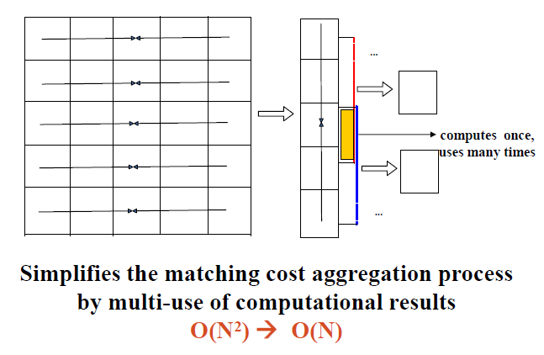
Two-Pass Aggregation

Slide 18
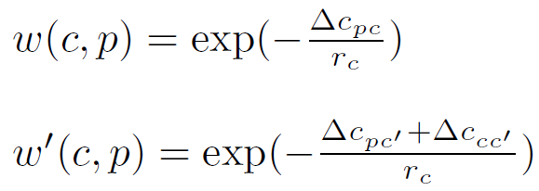
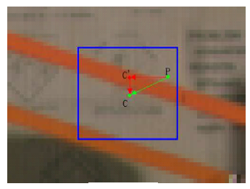
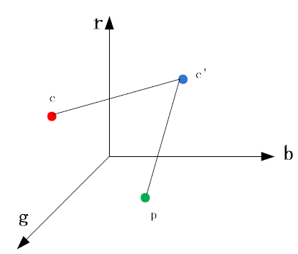
Two-Pass Aggregation

Slide 19
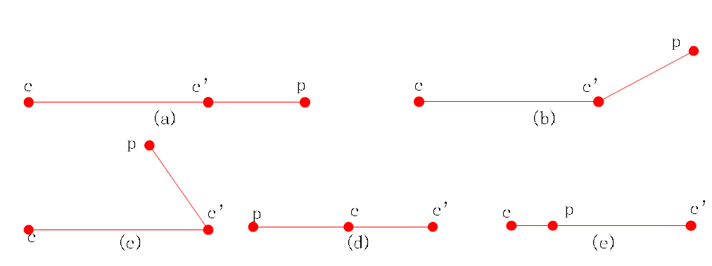




Credibility Estimation
0 $≤(∆c\text{p}c′+∆\text{c}\text{c}\text{′}\text{c}\text{)}−∆\text{c}\text{p}\text{c}≤2×min(∆c\text{p}c′,∆\text{c}\text{c}\text{′}\text{c}\text{)}$
The larger the$∆c\text{p}c′$ and $∆\text{c}\text{c}\text{′}\text{c}$ , the larger the accuracy loss.
using credibility estimation to reduce it

Slide 20
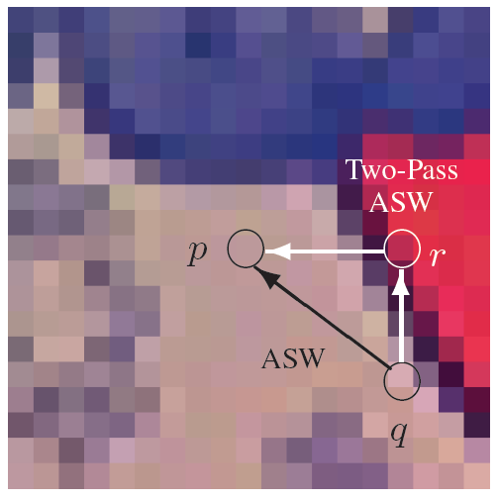
Credibility Estimation
C
C’
P

Slide 21

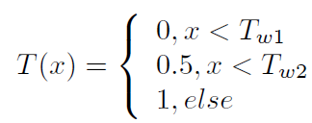
Credibility Estimation
Compute support weight and its credibility：
T(x) :
Excludes points which may be unreliable from two-pass aggregation

Slide 22
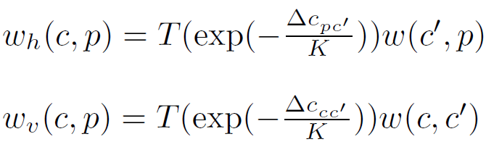
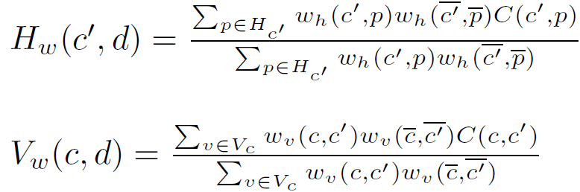
Two-Pass Aggregation
Judge ω’(c,p) :
Aggregation matching cost:
H_{c’} : the set off all pixels locate on the same line with c’
V_{c} : the set off all pixels locate on the same column with c

Slide 23
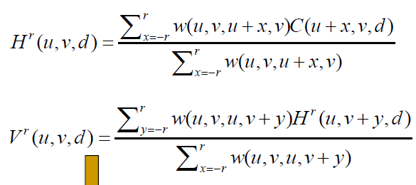
Two-Pass Aggregation
Judge ω’(c,p) :
Aggregation matching cost:
c
p_{i}
pixel-wise cost
c

Slide 24
Two-Pass Aggregation

Slide 25
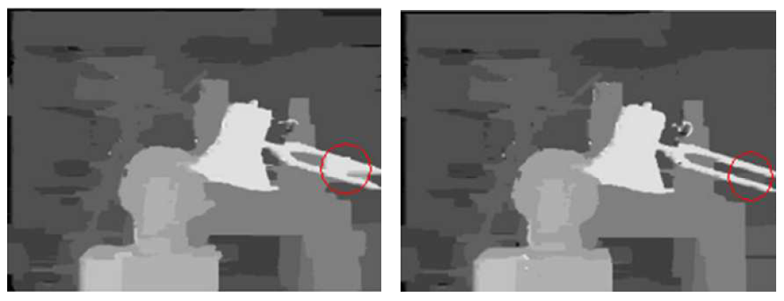
Comparison
Without Credibility Estimation
With Credibility Estimation

Slide 26
Winner-take-all guided DP

Slide 27
Winner-take-all guided DP
Adopt amended scan-line optimization technique
Combines -
Winner-Take-All (WTA)
Dynamic Programming (DP)
Improving depth estimation at occlusion boundaries
Better preserves depth discontinuities

Slide 28

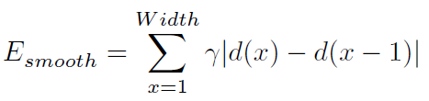
Dynamic Programming (DP)
Energy minimization framework
Objective : find disparity function d
Aggregate matching cost
γ : penalize of depth discontinuities
Width : image width

Slide 29
Dynamic Programming (DP)
Energy minimization framework
Objective : find disparity function d
γ : penalize of depth discontinuities
Width : image width

Slide 30
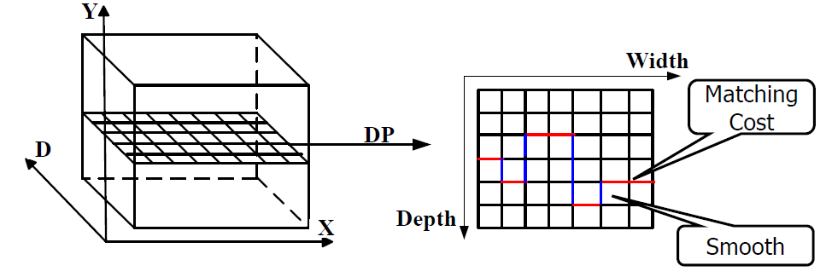
Dynamic Programming (DP)
Scanline optomization :

Slide 31
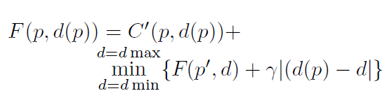
Dynamic Programming (DP)
Traverse the aggregated costs along each scan-line from left to right
Maintain the minimal accumulated costs (up to current position)
- p = (x,y) , p’ = (x-1,y)
For pixel p
Traverse the all the disparities d(p’)
Calculate the minimum energy
Sum cost
Sum cost
Minimize
O(D²) ( D : disparity search range) not suitable for real-time system

Slide 32

Dynamic Programming (DP)
Only consider d(p)-1, d(p), d(p)+1 as disparity smoothness constrain
A pixel usually have similar disparity with surrounding pixels
O(D) ( D : disparity search range)
disparity change slowly at depth discontinue areas
blur the occlusion borders (over-smooth) WTA

Slide 33


Winner-Take-All (WTA)
Combine WTA and scanline DP
Better handle in depth discontinuity areas
Fourth disparity candidate :

Slide 34
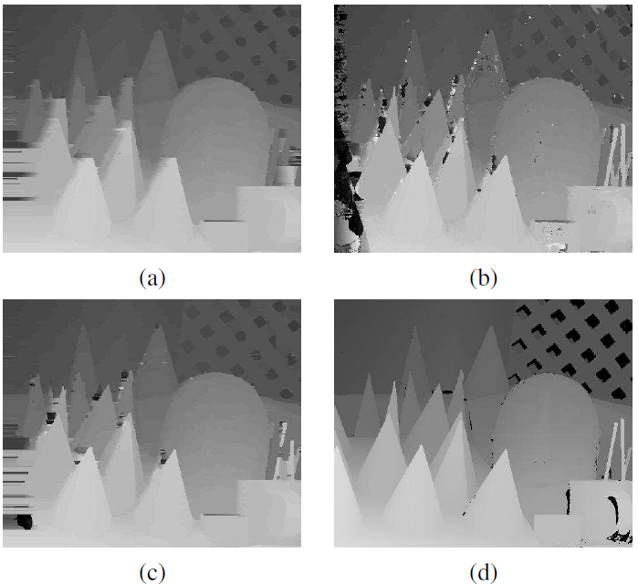
Comparison
DP method
WTA
DP + WTA
Ground
Truth

Slide 35
Experimental Results

Slide 36
Experimental Results
Intel W3350 CPU with 3.0 GHZ
Geforce GTX 285 graphics card
Cost aggregation : using CUDA on the GPU
support window (35*35)
K=2, γ_{c}=36, discontinuity cost (γ =3.25)

Slide 37
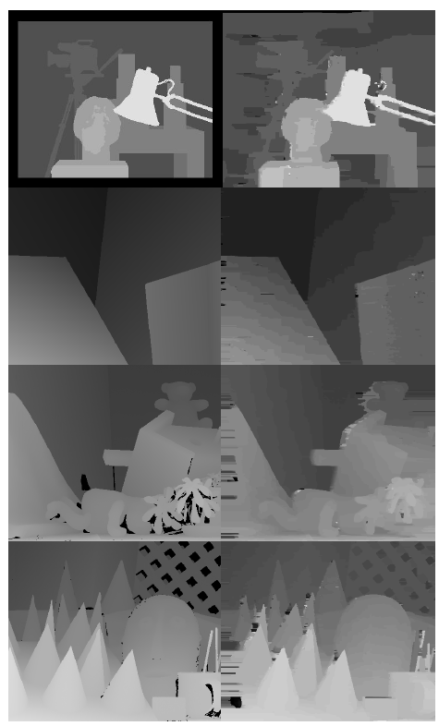
Ground Truth
Proposed

Slide 38
Experiment on dynamic scene
Live videos captured by a bumblebee XB3 camera
Achieve 20 fps when:
handing stereo image pairs of 320×240 pixels
with 24 disparity levels
Equivalent to 36.87 MDE/s
(MDE/s)：
‧Million Disparity Evaluations per second
‧(number of pixels) * (disparity range ) * (obtained frame-rate)
‧captures the performance of a stereo algorithm in a single number

Slide 39
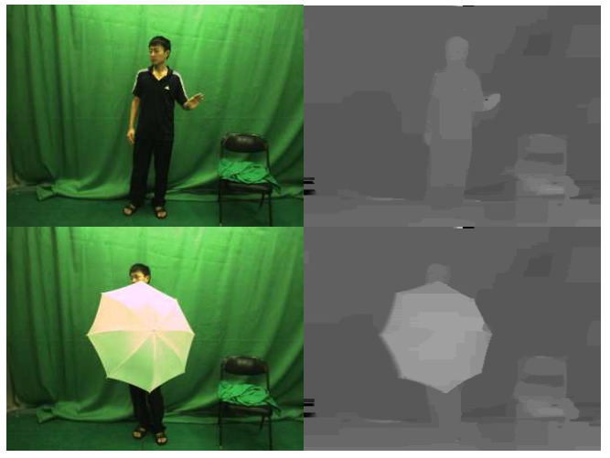
Experiment on dynamic scene

Slide 40
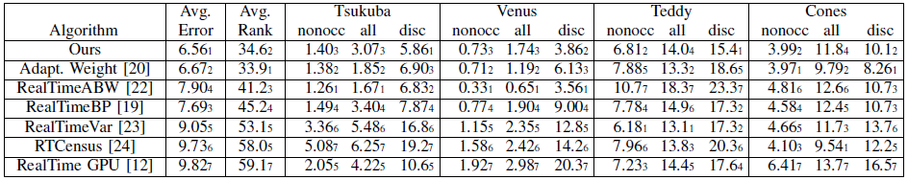
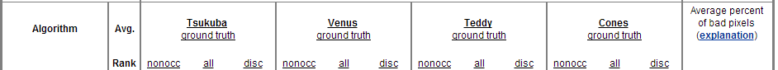
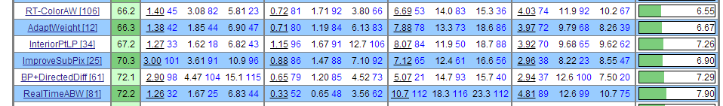
Experimental Results

Slide 41
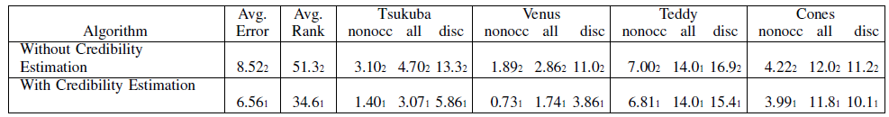
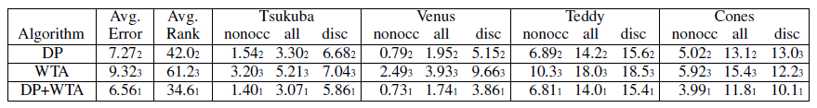
Experimental Results
Without & With Credibility Estimation
DP vs. WTA vs. DP+WTA

Slide 42
Conclusion

Slide 43
Conclusion
Propose a high quality real-time stereo algorithm
Two-pass aggregation
Aggregate matching cost
WTA
Improve DP optimization technique
Improve depth estimation at occlusion boundaries
CPU and GPU in parallel
High-quality depth map at video frame rate
Best accuracy among all real-time algorithms

